Slide 1

MTO Development
Fantasy Hockey Projector

Slide 2

MTO Development

Slide 3
Fantasy Hockey Projector

Slide 4
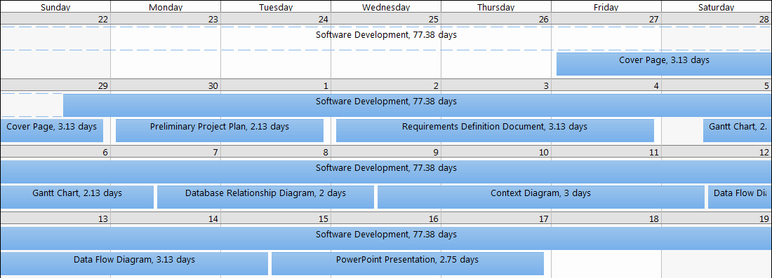
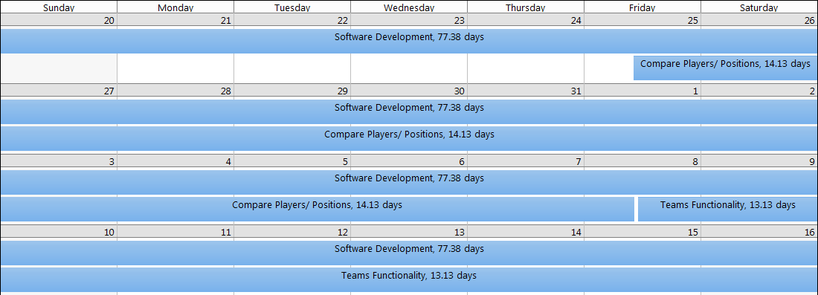
Fantasy Hockey Projector

Slide 5
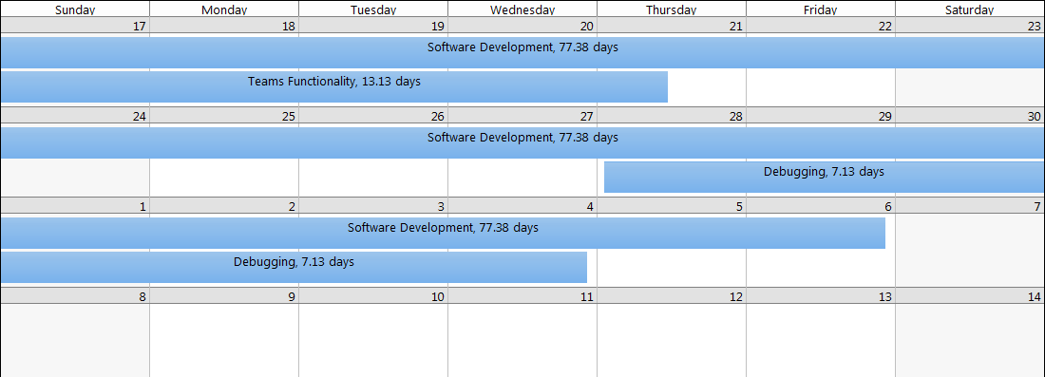
Fantasy Hockey Projector

Slide 6


Fantasy Hockey Projector
The Fantasy Hockey Projector is written in Java
The Fantasy Hockey Projector uses a MySQL database to store and retrieve data

Slide 7
Fantasy Hockey Projector
Users can search for players individually by team or by position
Administrator's can log in to Add players, Delete players and Update players information
Administrators can Add teams, Delete teams and Update team information
Users can not Add, Delete, or Update any information.

Slide 8
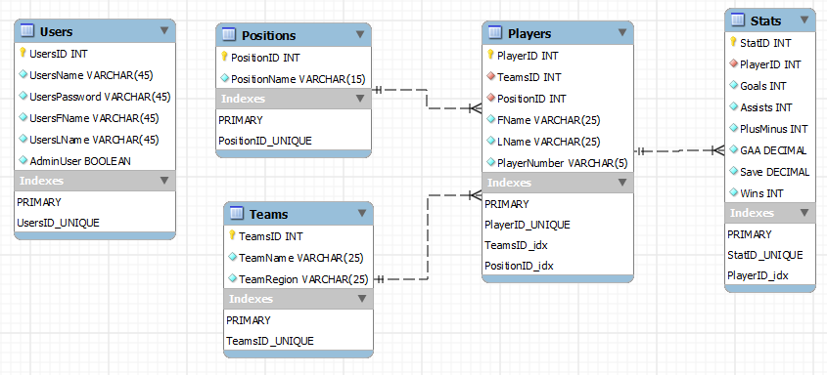
Fantasy Hockey Projector
Entity Relationship Diagram

Slide 9
Fantasy Hockey Projector
Users Table keeps track of the UsersID, UsersName, UsersPassword, UsersFName, UsersLName and if Admin – The Users Table does not have any relationships to the other tables
Postions Table keeps track of the PositionID and Position Name – the Positions Table has a one to many relationship with the Players Table
Teams Table keeps track of TeamsID, TeamName, and TeamRegion – the Teams Table has a one to many relationship with the Players Table
Players Table keeps track of PlayersID, TeamsID, PostionID, FName, LName, and PlayerNumber – Players Table has a one to many relationship with the Stats Table
Stats Table keeps track of StatID, PlayerID, Goals, Assists, PlusMinus, GAA, Save, and Wins – Stats Table has a many to one relationship with the Players Table

Slide 10
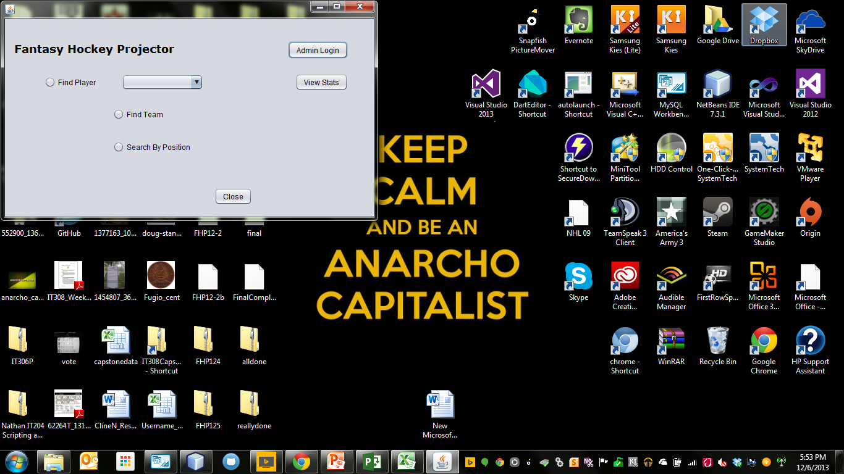
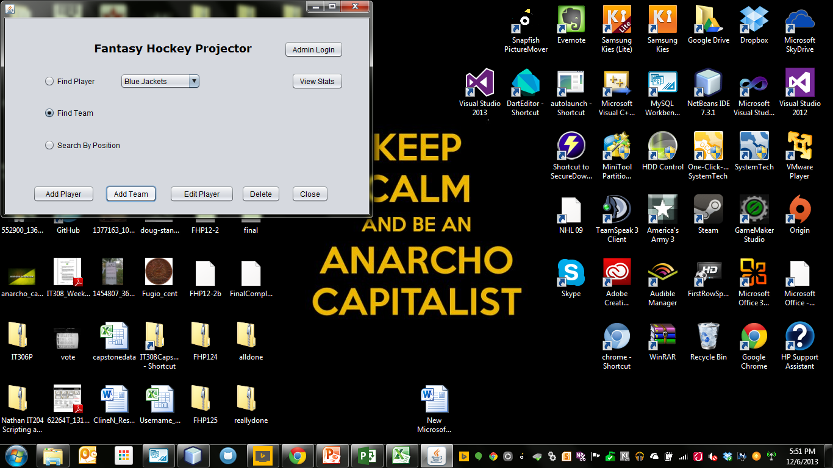
Fantasy Hockey Projector
Main GUI Page before login
Main GUI Page with successful login
All Users
Admins Only

Slide 11
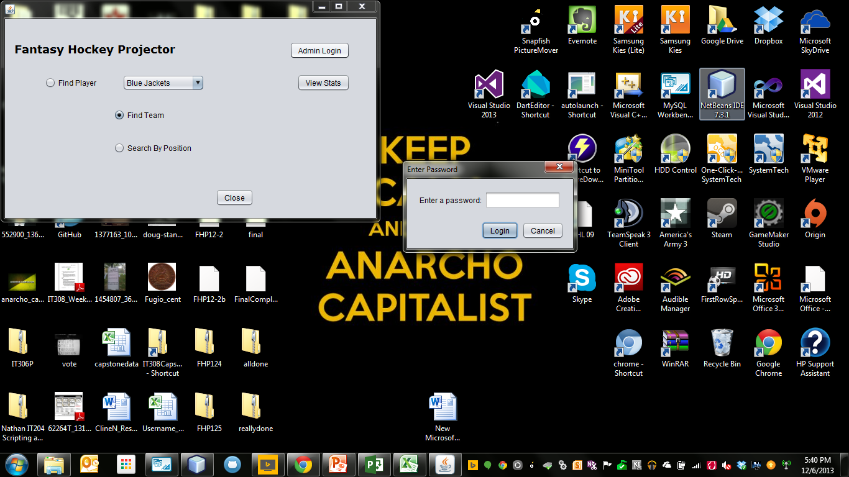
Fantasy Hockey Projector
Admin Login page
Only Admin’s need to login

Slide 12
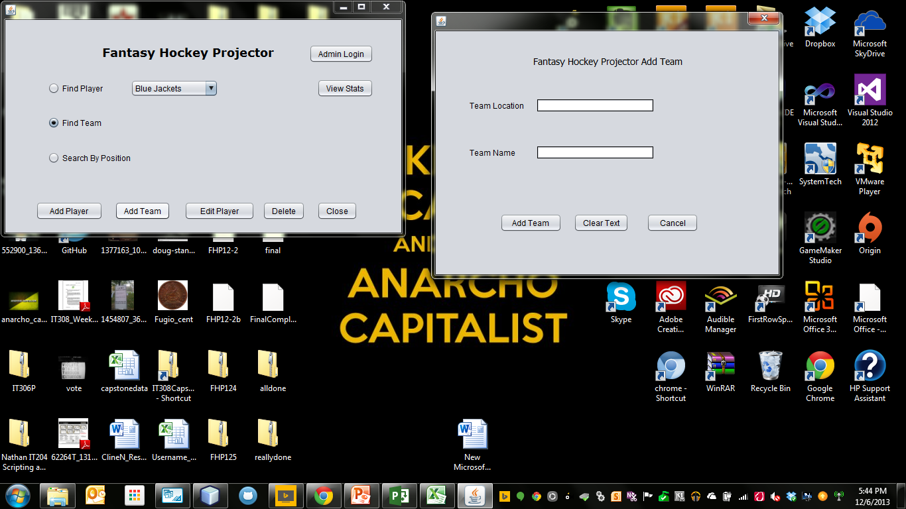
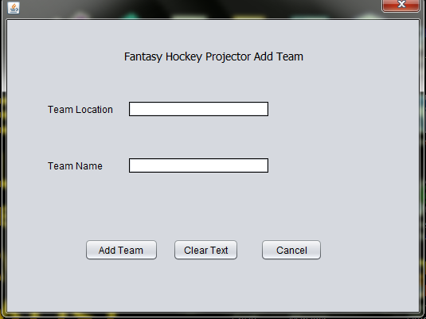
Fantasy Hockey Projector
Add Player Dialog
Add Team Dialog

Slide 13
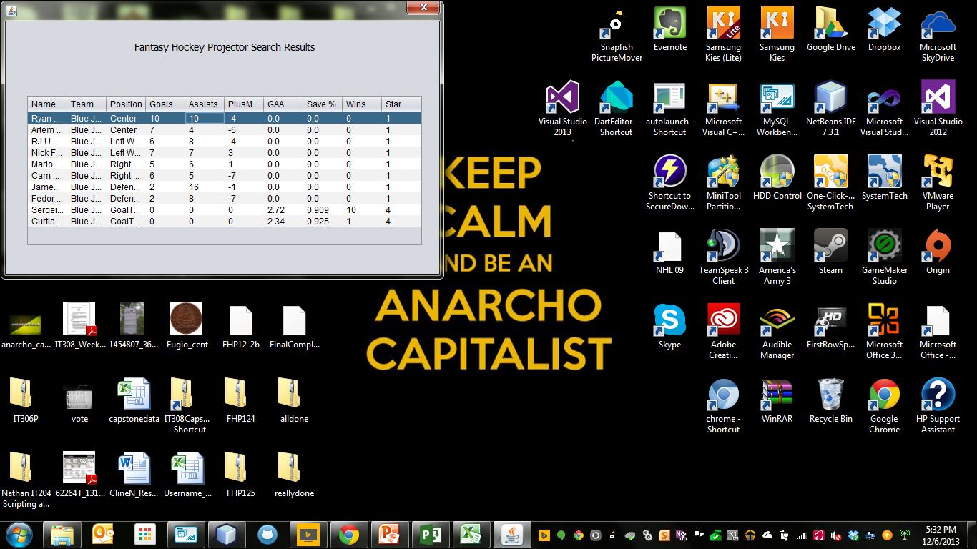
Fantasy Hockey Projector
Results Table

